Slide 1
ITD03 Extending Dynamics NAV using .NET framework interoperability
Erik Hougaard

Slide 2
Notes to the Presenter
Please save this file using the session code and title, e.g., “FIN08 – Best Practices with Year-end Closing”
Slides 2-6 contain notes for the presenter, and are hidden.

Slide 3
Notes to the Presenter
You may include your picture and company logo on the intro slide only (slide 8).
The “Suggested Sessions” slide (slide 15) is for you to highlight related sessions remaining on the schedule. This is optional; please delete if not used.

Slide 4
Notes to the Presenter
It is appropriate to provide a brief background (1 minute or less) on your organization.
Attendees love when you submit your slides and reference materials in advance (materials can be included in these slides or separate).
Submit your slides and reference materials by October 1 to events@navug.com

Slide 5
Quick Best Practices
Frame your presentation by answering:
  What do you want your audience to learn?
  What do you want your audience to do differently?
  What result or outcomes do you want your audience to realize?
Clarify your session objectives up front.

Slide 6
Quick Best Practices
Use more pictures, far less words (7 words on a slide is wonderful).
Alternate communication methods, e.g., polls or videos, to increase attention and interaction.

Slide 7
Quick best practices
Plan and follow a rough agenda, e.g.:
  5 minutes – opening, objectives, intros
  5 minutes – share story
  15 minutes – slides
  20 minutes – demo
  5 minutes – final Q&A
  5 minutes – wrap-up and surveys

Slide 8
Stump the experts: Dev best practices
Session objectives:
?
Notes:
Need to make quick, accurate business decisions? Do an SSRS report! Need to have information at your fingertips? Want reports based on Account Schedules and other data out of NAV? Daily flash reporting in use at your company? Should it be? This is your power-packed session on how to design your reports using SSRS reporting, including examples of ways to look at your financial data (or any data in NAV!) in ways that will be more impactful.

Slide 9

Your presenters
Erik Hougaard
R&D Manager
E Foqus
Microsoft MVP for 2 years

Slide 10
TWEET ME
Throw a tweet at me if you got a DotNet thing I should try to cover at the end of this session.
In general, tweet me if you got NAV questions
@eHougaard

Slide 11
.NET interoperability in NAV 2013-2016
A way to access parts of the .NET Framework from C/AL
Even though C/AL gets compiled into C# - It is not C# and C# is not .NET
Access to 3rd party .NET Libraries
Forget COM or .NET based automation controllers
Objects, classes, namespaces

Slide 12
.NET interoperability challenges
Named and Optional Arguments MSDN Link
Dynamics NAV 2016 has ISNULL but not a NULL “variable”.
If you need NULL, cheat and create a System.Object DotNet variable without value, it will work in most cases:
Null DotNet System.Object

Slide 13
.net versions
.NET 1.0
.NET 1.1 (This is your syntax level)
.NET 2.0
.NET 3.5
.NET 4.0 (client, server, full)
.NET 4.5.x (This is NAV2016)
.NET 4.6

Slide 14
THE LONG ROAD FRom CODE TO EXECUTION
C/AL
C#
IL
ASSEMBLER
NAV Compiler
C# Compiler
JIT Compiler

Slide 15
The search for class …
Namespaces
assemblies
System
System.Net
System.Net.HttpRequest
System
System.Net
mscorlib

Slide 16
Two categories of assemblies
Global
Assembly
Cache
(GAC)
Locally placed .DLL files
(In the Add-ins folders)

Slide 17
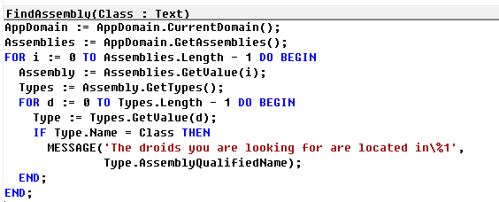
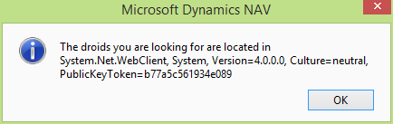
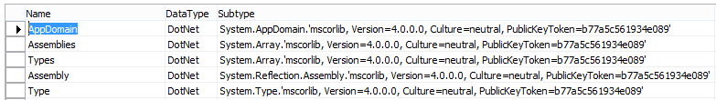
Reflection to the rescue

Slide 18
Static vs. instance
A static .net variable is ready
A type must be instantiated
Examples:
  System.OI.File
  System.OI.Path
Anything else ☺
The constructor is named as the class:
Myvar := Myvar.MemoryStream();

Slide 19
Streaming all the way …
.NET
Stream
NAV
InStream
NAV
OutStream
.NET
MemoryStream

Slide 20
MemoryStream – Your new ad-hoc Stream
A “in-memory” BLOB you can stream in and out from.
Remember to reset the “read pointer” before trying to read after writes:
MemoryStream.Position := 0;
Works great with a StreamReader or StreamWriter to give samme interface as InStream and OutStream.
.NET
MemoryStream

Slide 21
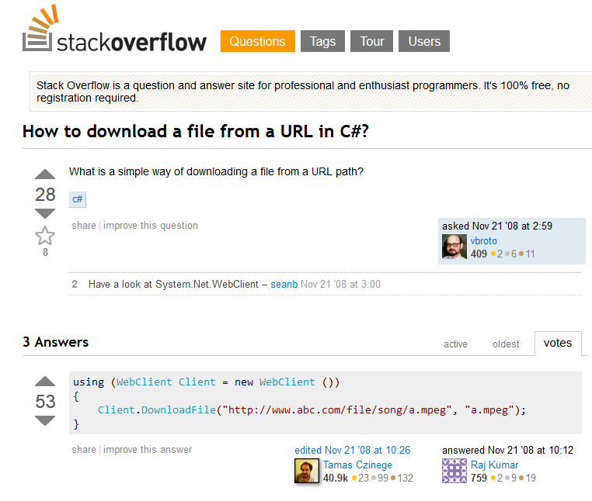
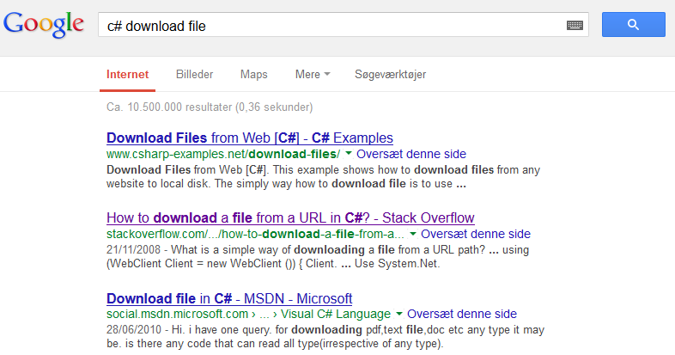
Google-Fu ! (Or BingJa’ing)
The internet is filled with tons of examples of doing stuff in C# - Just remember to add “C#” to your search queries

Slide 22
Files are evil
Everything happens on the server now
Filling up the servers temp drive may bring the entire server down
No way for a user to clean a temporary after a failure
Potential sharing issues
Security issues with files on the server, who can read the content ?
Solution: Always use streams !

Slide 23
SERVER vs. CLIENT
DotNet variables can exist on:
Service Tier
Client

Slide 24
CLIENT .NET CODE vs JAVASCRIPT
Design pattern:
Don’t use .NET on client, it does not work with web/tablet/phone/universal clients
Use Javascript

Slide 25
HTTP
HTTP is really, really easy ….

Slide 26
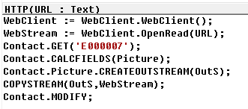

Use WebClient to get HTTP
Open the URL with WebClient
Setup the streams and copy directly from WebClient to the BLOB field on the contact

Slide 27
FTP
FTP is a bit more complicated ….

Slide 28
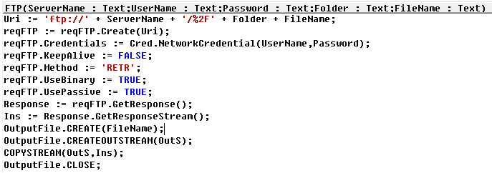
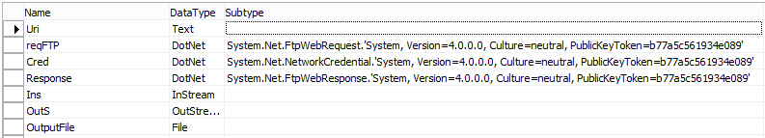
FTP is a command based protocol
Connect to the FTP server and execute a command.
“RETR” is the command for getting a file.
Again, uses stream to copy the content directly.

Slide 29
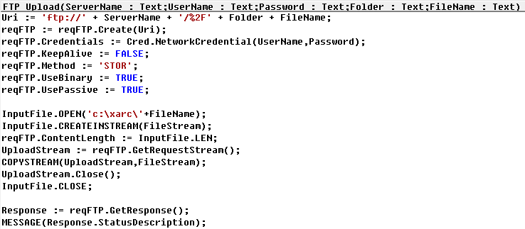
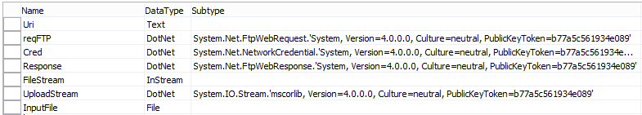
Lets try to upload a file from NAV 2016
Connect to the FTP server and execute a command.
“STOR” is the command for getting a file.
Again, uses stream to copy the content directly.

Slide 30
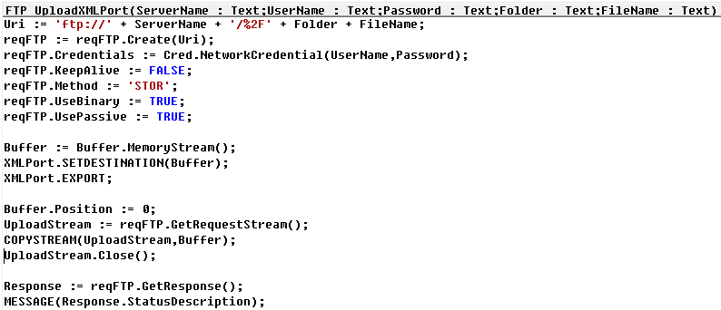
Lets try to upload from a XML Port
Connect to the FTP server and execute a command.
“STOR” is the command for getting a file.
Now we most go through a buffer stream to get the XML Port to behave nicely.

Slide 31
SSH / SFTP / SCP
Hmm.. This time we have to wander off the beaten path and venture outside the standard .NET Framework …

Slide 32

Secure Shell
The defacto standard for communication with Unix/Linux machines
SSH replaces Telnet
SFTP replaces FTP
SCP replaces “remote copy” / uucp etc..
SSH can tunnel TCP/IP traffic acting like a VPN

Slide 33
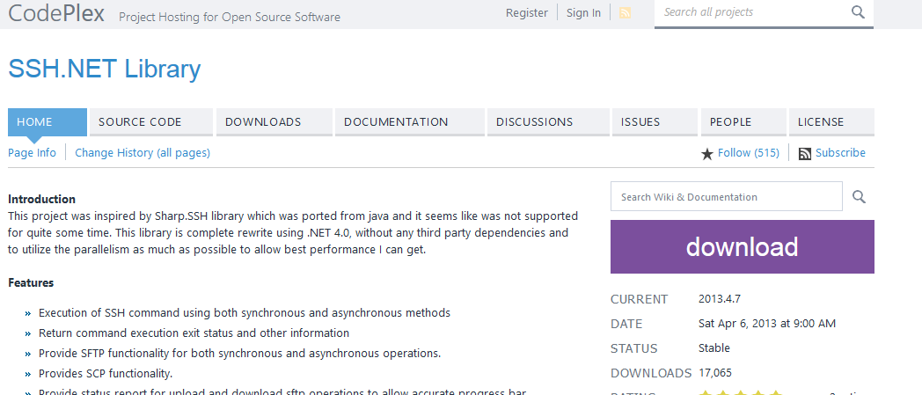
Find an open source library …

Slide 34
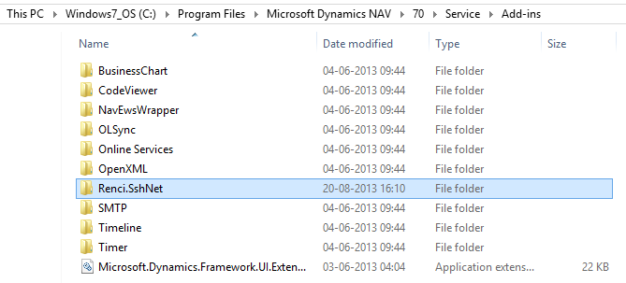
Place the .DLL files into the add-ins folder
Create a folder in the Add-ins folder on BOTH the service tier and the client.
Copy the .DLL files into the folder
Restart Server and Client

Slide 35
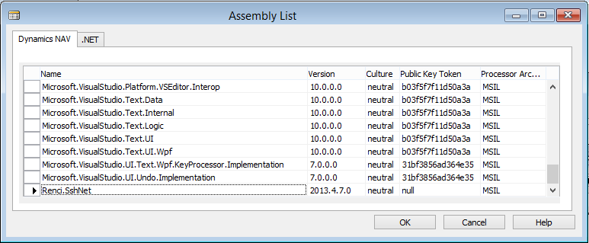
Then it can be found in the ”Dynamics NAV” part of the Assembly List

Slide 36
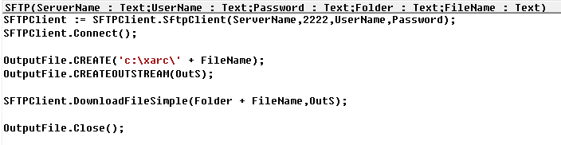
Now it is really simple to download a file
Again, create the client and connect.
Create a new file and get the outsteam
Download the remote file into the stream.

Slide 37
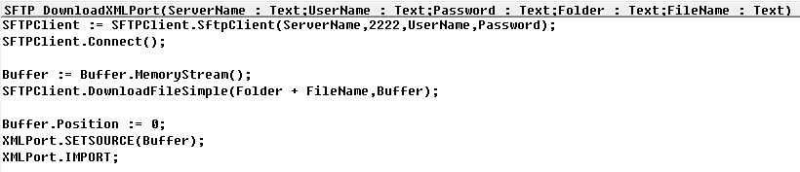
Lets try to download into a XML Port
Again, create the client and connect.
Download the file into a MemoryStream
Use the MemoryStream as source and import with the XML Port

Slide 38
AES256 Hash Keys

Slide 39
What is a Hash Key ?
Variable Length Data (Binary)
Fixed Length Hash Key

Slide 40
Sign data or verify signed data …
NAV
2013-2016
External data
with hash key
External data
with hash key
Import and verify
Export and
sign

Slide 41
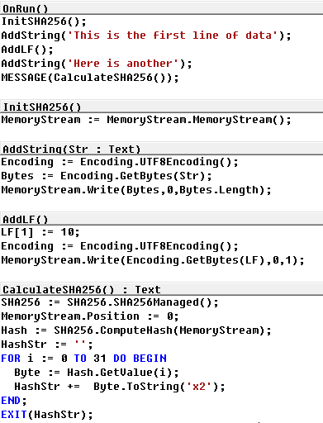
SHA256 Example
Uses a MemoryStream to hold the data that needs to calculated.
Add data to the stream, encoding is used to convert NAV Unicode strings into a binary data.
Remember to add control characters (In this case line feed) into the stream
Finally calculate the hash
In this case the hash is 256bit – it not very practical to move around, so it is formatted to a 64 characters hex string

Slide 42

Passwords ?
We can use SHA256 to store and secure passwords in NAV2015
(NAV2016 has a new encrypt/decrypt framework buildtin)

Slide 43
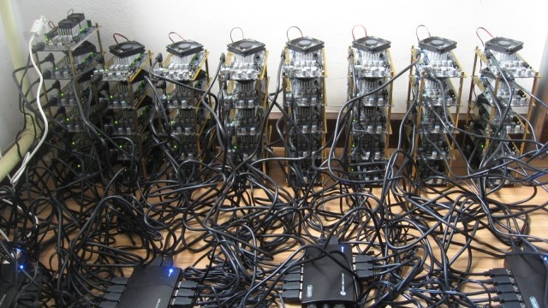
This is your enemy …

Slide 44
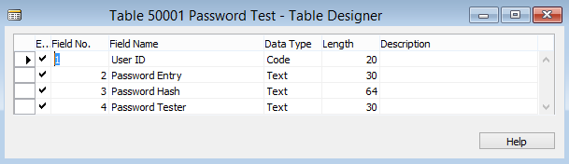
Lets create a password table

Slide 45
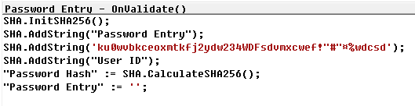
Password Creation
Init the hash
Add password, user and salt to the hash
Calculate the hash and clear the entry

Slide 46
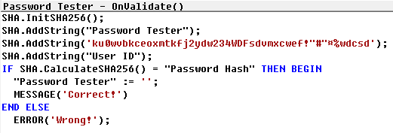
Password Verification
Init the hash
Add password, user and salt to the hash
Calculate the hash and test against the stored hash

Slide 47
Stuff that will BYTE you in the …..
Hash calculations are done on binary data – So you need to decide what encoding (if any) your data has. NAV 2015 uses 16-bit Unicode.
Salts must be kept secret, but thats really hard in NAV2015 – One solution is to hide it in a .NET assembly.

Slide 48
What about the other way around ?
Simple protocol
communication
(aka. Telnet)
NAV 2015
Service Tier
Server and Listener

Slide 49
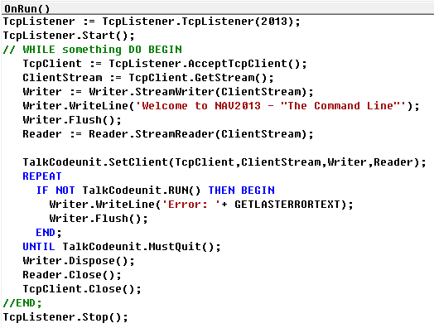
Let us create a TcpListener
Open the port for listening
Wait for a connection
Setup stream and welcome user
Call ”execution” codeunit
Error handling
Dispose and release resources
Stops listening

Slide 50
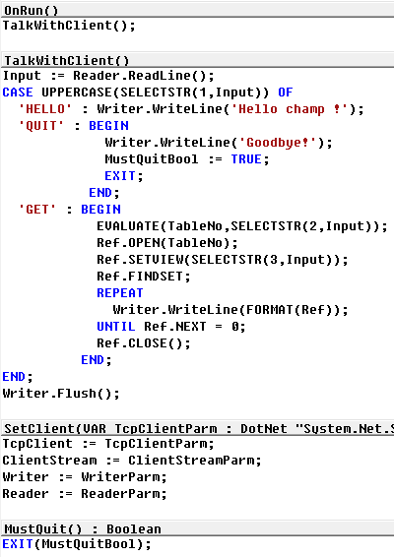
Execution Codeunit
Read input from Tcp socket
Execute different functions
Flush the outgoing stream
Setup stuff

Slide 51
WAIT, you said something about
.NET Versions and something about the C/AL syntax?

Slide 52
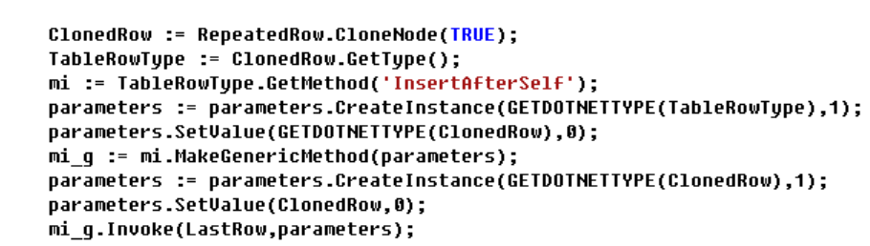
USE REFLECTION TO OVERCOME the 1.1 limit
Reflection gives the ability to create one the fly function calls

Slide 53
.NET Usage in NAV2016 - TOP 46
System.Xml.XmlNode | 262
System.Xml.XmlDocument | 115
System.Xml.XmlNodeList | 34
Microsoft.Dynamics.Nav.Client.BusinessChart.BusinessChartDataPoint | 23
System.Xml.XmlNamespaceManager | 15
Microsoft.Dynamics.Nav.DynamicsOnline.Types.IBasicPaymentInfo | 15
System.String | 14
Microsoft.Dynamics.NAV.OLSync.OLSyncSupplier.OutlookPropertyList | 14
Microsoft.Dynamics.NAV.OLSync.Common.XmlTextWriter | 12
System.Globalization.CultureInfo | 11
System.Convert | 11
System.Text.Encoding | 11
Microsoft.Office.Interop.Word.ApplicationClass | 10
Microsoft.Office.Interop.Word.Document | 10
Microsoft.Dynamics.Nav.Exchange.IEmailMessage | 10
Microsoft.Dynamics.NAV.OLSync.Common.XmlTextReader | 10
Microsoft.Dynamics.Nav.Client.BusinessChart.BusinessChartBuilder | 10
System.Net.HttpStatusCode | 9
System.Collections.IEnumerator | 8
System.Collections.ArrayList | 8
System.Data.DataRow | 8
Microsoft.Dynamics.Nav.Encryption.IEncryptionProvider | 8
System.Uri | 8
System.DateTime | 7
System.Text.RegularExpressions.Regex | 7
Microsoft.Dynamics.Nav.DynamicsOnline.Types.IProxyContext | 7
System.Collections.Specialized.NameValueCollection | 7
DocumentFormat.OpenXml.StringValue | 7
Microsoft.Dynamics.Nav.DocumentReport.WordReportManager | 7
Microsoft.Dynamics.Nav.OpenXml.Spreadsheet.WorksheetWriter | 6
System.Xml.XmlElement | 6
System.Collections.Queue | 6
System.Net.NetworkCredential | 6
System.IO.StreamWriter | 6
System.Array | 6
System.Xml.XmlAttribute | 6
Microsoft.Dynamics.Nav.Integration.Office.Word.MergeHandler | 6
Microsoft.Dynamics.Nav.OpenXml.Spreadsheet.WorkbookWriter | 5
Microsoft.Dynamics.Nav.Types.Report.IReportChangeLogCollection | 5
System.Exception | 5
Microsoft.Dynamics.NAV.OLSync.OLSyncSupplier.OutlookPropertyInfo | 5
System.Xml.XmlNamedNodeMap | 5
Microsoft.Dynamics.Nav.Client.BusinessChart.BusinessChartMultiLanguageText | 5
Microsoft.Dynamics.Nav.Client.Capabilities.CameraOptions | 5
Microsoft.Dynamics.Nav.Client.Capabilities.CameraProvider | 5
Microsoft.Dynamics.Nav.Client.CodeViewerTypes.BreakpointCollection | 5

Slide 54
.NET Usage in NAV2015 – TOP 49 ->
Microsoft.Office.Interop.Excel.Worksheet | 4
System.Type | 4
System.IO.File | 4
System.Windows.Forms.DialogResult | 4
System.Xml.XmlAttributeCollection | 4
System.Net.HttpWebRequest | 4
Microsoft.Dynamics.Nav.Exchange.IEmailFolder | 4
DocumentFormat.OpenXml.UInt32Value | 4
DocumentFormat.OpenXml.BooleanValue | 4
Microsoft.Office.Interop.Excel.ApplicationClass | 3
Microsoft.Dynamics.Nav.Integration.Office.Excel.ExcelHelper | 3
Microsoft.Dynamics.Nav.OpenXml.Spreadsheet.CellDecorator | 3
System.Data.DataTable | 3
Microsoft.Dynamics.Nav.Client.BusinessChart.DataMeasureType | 3
System.Text.RegularExpressions.RegexOptions | 3
System.Globalization.DateTimeStyles | 3
Microsoft.Dynamics.Nav.DocumentReport.RdlcReportManager | 3
System.IO.Directory | 3
System.Windows.Forms.FolderBrowserDialog | 3
System.IO.StreamReader | 3
System.IO.FileMode | 3
System.Text.UTF8Encoding | 3
System.Web.HttpUtility | 3
Microsoft.Dynamics.Nav.DynamicsOnline.Types.ITransactionResult | 3
Microsoft.Dynamics.Nav.DynamicsOnline.UserManagement | 3
System.Xml.XmlNodeType | 3
System.Net.HttpWebResponse | 3
System.Net.WebException | 3
System.Net.Cookie | 3
System.UriKind | 3
Microsoft.Dynamics.Nav.Integration.Office.Word.WordHelper | 3
Microsoft.Dynamics.Nav.Exchange.IEmailAddress | 3
Microsoft.Dynamics.Nav.Exchange.ExchangeServiceWrapper | 3
Microsoft.Dynamics.Nav.Exchange.ServiceWrapperFactory | 3
Microsoft.Dynamics.Nav.Timer | 3
DocumentFormat.OpenXml.Packaging.WorkbookPart | 3
DocumentFormat.OpenXml.Packaging.VmlDrawingPart | 3
DocumentFormat.OpenXml.Spreadsheet.Comments | 3
System.Collections.Specialized.StringCollection | 3
Microsoft.Dynamics.Nav.NavDocumentService.NavDocumentServiceHelper | 3
Microsoft.Dynamics.Nav.DocumentReport.ReportUpgradeCollection | 3
Microsoft.Dynamics.Nav.OpenXml.Spreadsheet.WorkbookReader | 2
Microsoft.Dynamics.Nav.OpenXml.Spreadsheet.WorksheetReader | 2
Microsoft.Dynamics.Nav.OpenXml.Spreadsheet.CellData | 2
System.IO.Path | 2
System.DateTimeKind | 2

Slide 55
System.text.encoding
This slide used to host a really clever trick – then NAV2016 came along and added the feature to standard NAV streams ☺
But in case of NAV2013-2015 – this trick is still valid.

Slide 56
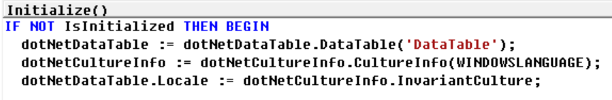
CultureInfo
Get access to formatting data as:
Windows Language
Invariant

Slide 57
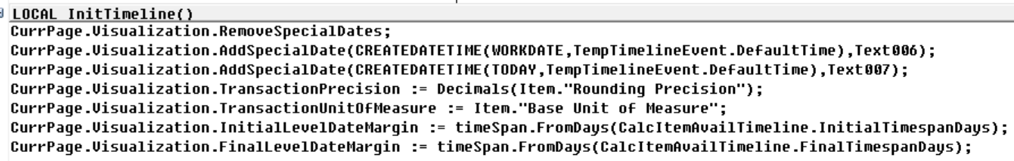
TimeSpan Class
Convert between different time units – Years, Month, Days, Hours, Minutes, Seconds, Miliseconds, Ticks
Example from page 5540

Slide 58
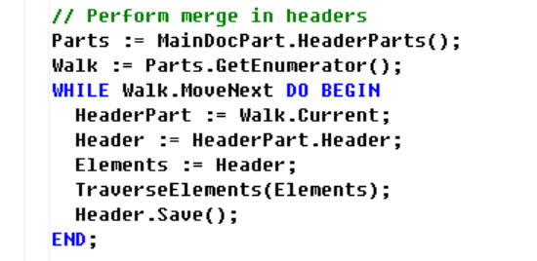
Enumerator
c# example:
foreach(var HeaderPart in Parts)
{
<c# code ….>
}
In NAV2016 you have ”native” FOREACH (only on .NET variables) that performs this operation.

Slide 59
System.io.file
File.Read* - Read an entire file
File.Write* - Write an entire file
File.Append* - Append a file
File.Move
File.GetAttributes

Slide 60
SYSTem.io.path
Resolve partial paths to complete paths GetFullPath(String)
Combine paths Combine(String, String)
Check for root IsPathRooted(String)
Get path for temporary files (Remember, BAD) GetTempPath()

Slide 61
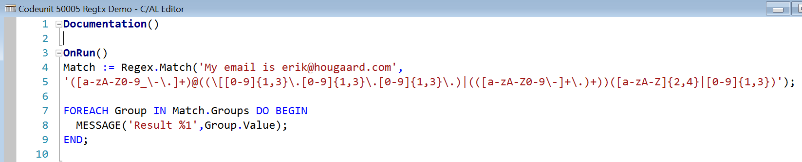
REGULAR EXPRESSIONS
Regular expressions is a way to parse, get details from text string.
Example:
A decimal number in a string: (\+|-)?[0-9]+(\.[0-9]*)?

Slide 62
Regular expressions - examples
\B Matches a non-word boundary. "ea*r\B" matches the "ear" in "never early"
\d Matches a digit character. Equivalent to [0-9].
\D Matches a non-digit character. Equivalent to [^0-9].
\f Matches a form-feed character.
\n Matches a newline character.
\r Matches a carriage return character.
\s Matches any white space including space, tab, form-feed, etc. Equivalent to "[\f\n\r\t\v]".
\S Matches any nonwhite space character. Equivalent to "[^ \f\n\r\t\v]".
\t Matches a tab character.

Slide 63
AND WE COULD CARRY ON…
Questions ?
Tweets ?
Letters ?

Slide 64

Q&A

Slide 65
Code Example
Use Consolas font for inserting example code.

Slide 66
Suggested sessions
Fri, 10:30
23 tips and tricks for developers
Fri, 13:00
An elegant solution for creating Dynamics NAV user documentation

Slide 67
Contact info
Erik Hougaard
  erik@hougaard.com

Slide 68
Thank you!
Complete your survey now!
Download these slides from navug.com
Ask questions and connect in the Summit 2015 community
Submit your town hall questions to townhall@navug.com
Visit the I Love NAV booth #233
  Wed 6:00 – 8:00
  Thu 12:00 – 2:00
  Fri 10:00 – 12:00
Visit the NAVUG Medics in the ABC Computers Hub
Have fun!

